Slide 1
So a fight director and a doctor walk into a bar…
Aaron Anderson, PhD, Department of Theatre, School of the Arts
Alan Dow, MD, MSHA, Department of Internal Medicine, School of Medicine

Slide 2
Follow-up
Outcomes
History
Exam/Studies
Treatment
Rapport
Rapport
Rapport

Slide 3
“Art though not Romeo, and a Montague?”
Angry
Coy
“Neither, fair maid, if either thee dislike.”
Apologetic
Flirtatious

Slide 4
“Is this serious?”
Anxious
Puzzled
“We need to perform some tests.”
Reassuring
Explanatory

Slide 5
Initial Study Design
Intervention:
14 internal medicine residents.
6 hr workshop session – theatre-based pedagogy.
Control:
6 residents.
Assessment:
Patient visits in their continuity clinics.
Pre and Post.
Scored on a modified scoring tool used within the Theatre Depart to assess student performance.

Slide 6
Domain | Control | Intervention | Effect Size (p value)
Empathy | 6.93 | 8.64 | 1.7 (0.004)
Relating | 7.14 | 8.72 | 1.8 (0.01)
Non-verbal | 7.39 | 8.86 | 1.4 (0.01)
Verbal | 7.07 | 8.47 | 1.0 (0.058)
Respect | 7.09 | 8.37 | 1.9 (0.002)
Overall | 5.82 | 8.56 | 1.5 (0.007)

Slide 7
Nursing Data
Median Scores
By Training Content
Non-Verbal
Building Rapport
Empathy
Pre Retro Post
Pre Retro Post
Pre Retro Post

Slide 8
Geri/Palliative Data
Difficult
Conversations
Building
Rapport
Active
Listening
Teaching
Assessing

Slide 9
Other Accomplishments
Phenomenology
Book chapter
Other learner groups (VCU, External)
Lectures, Posters, Workshops (Nationally, Internationally)
Educational Innovation/Educational Research Award
PRIP Award
Standardized Patient Program

Slide 10
How we got started…

Slide 11
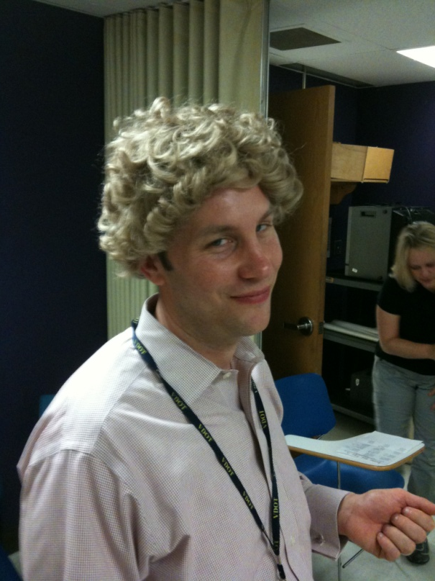
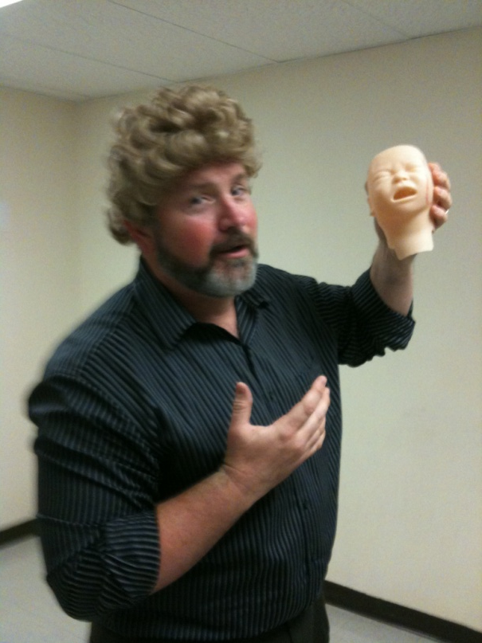
How we keep going…
Challenging problem
Evolving theory
Friendship

Slide 12
So a doctor and a fight director walk into a bar…
Aaron Anderson, PhD, Department of Theatre, School of the Arts
Alan Dow, MD, MSHA, Department of Internal Medicine, School of Medicine

